Slide 1
Personal KanbanBoard

Slide 2
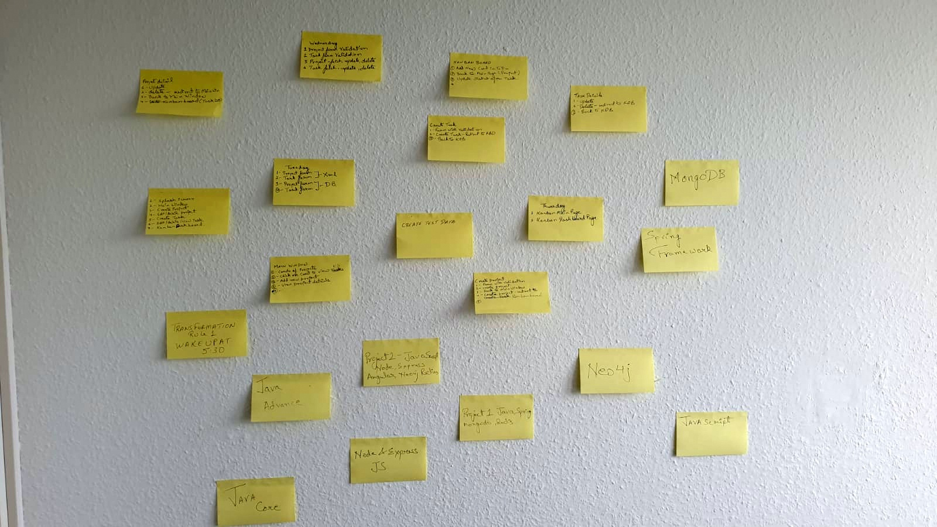
The Problem

Slide 3
The Solution
The User: A person who has goals and projects which he/ she needs to complete in the most efficient and organised way.
Personal Kanban Application should be for a single user where he can write down his on goals and projects, and manage them in the most efficient and organised way and has following features.
Write goals and its details as a project.
Set the start date and end date of the goal.
Break the Projects into small tasks.
Set their status and priority.
workflow for execution.
Task dependency mechanism
Visualize the workflow and the goals.

Slide 4
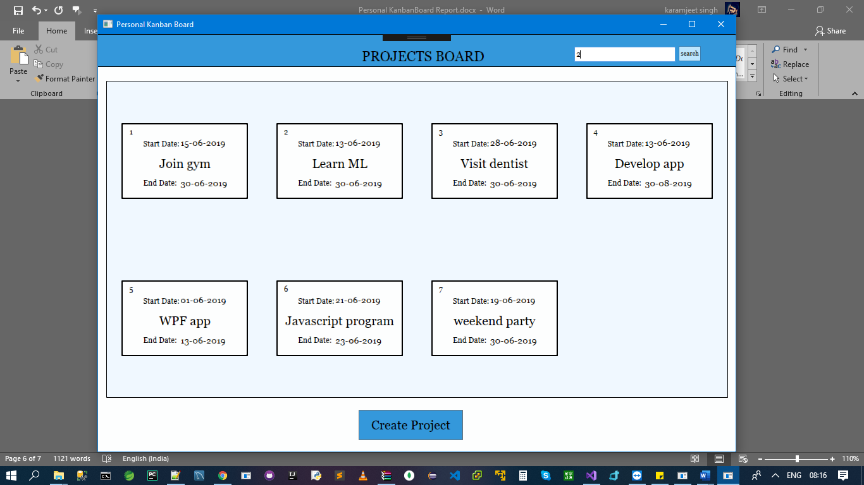
Personal Kanban Board

Slide 5
Thank You

